Slide 1
Ultimate Extensible Distributed System

Slide 2
Your Assignment
Your supervisor just handed you a spec for implementation of:
Distributed system with universal connectability using sockets
Can process an open-ended variety of documents
Expandable by 5 orders of magnitude in ten years
Can add new tools easily
Supports 50 million users a day without gridlock.

Slide 3
Introduction to Internet and Web
This presentation addresses two questions:
Is that possible?
Well yes – look over there – the web!
How was it accomplished?
Processing structure and protocols
Programming tools
Web servers and browsers that host:
Script languages, e.g., Javascript, VBScript, Perl, Ruby, …
Programming languages: Visual Basic, Java, C++, C#, …
And, of course, some very smart people

Slide 4
Goals of the Internet:
Build distributed system to share documents.
Support expansion by 5 orders of magnitude in ten years – 200 hosts to 500 million hosts.
Manage communication between hundreds of millions of machines every day without collapsing from congestion.
Provide for arbitrary extensions:
From static text documents to graphics, dynamic content, streaming video, programmable interfaces, voice, …

Slide 5
Original Goals of the Web
Universal readership
When content is available it should be accessible from any type of computer, anywhere.
Interconnecting all things
Hypertext links everywhere.
Simple authoring

Slide 6
Internet Design Principles
Goal is connectivity
Achieved with Internet Protocol (IP)
Stateless so survives failures – no need to backup
Made scalable with end-to-end intelligence
Transport Control Protocol (TCP)
Sender does not send until receipt is acknowledged
Amount sent is based on receiver’s current available buffer size – so receiver won’t be flooded.
Be strict when sending and tolerant when receiving
Protocol Specific Packet Headers
Internet Design
Robustness and the Internet

Slide 7
Web Design Principles
Universal
Decentralized
Modular
Extensible
Scalable
Accessible
Forward/backwards compatibility
Architecture of World Wide Web

Slide 8
Basic Concepts
Client/Server Model
Universal Addressing
TCP/IP, DNS
Search Engines
Universal Protocols
HTTP, URLs, HTML, FTP
Format Negotiation through HTTP
Hypertext → Hypermedia via HTML → XHTML
Support for text, images, sound, and scripting

Slide 9
Internet and Web History

Slide 10
Internet History
1961 – First paper on packet-switching theory, Kleinrock, MIT
1969 – ARPANet goes on line
Four hosts, each connected to at least two others
1974 – TCP/IP, Berkley Sockets invented
1983 – TCP/IP becomes only official protocol
1983 – Name server developed at University of Wisconsin.
1984 – Work begins on NSFNET
1990 – ARPANET shutdown and dismantled
1990 – ANSNET takes over NSFNET
Non-profit organization – MERIT, MCI, IBM
Starts commercialization of the internet
1995 – NSFNET backbone retired
1998 – DNS transferred from Dept of Commerce to ICANN
2000 – Web size estimates surpass 1 billion indexable pages

Slide 11
Web History
1990 – World Wide Web project
Tim Berners-Lee starts project at CERN
Demonstrates browser/editor accessing hypertext files
HTTP 0.9 defined, supports only hypertext, linked to port 80
1991 – first web server outside Europe
CERN releases WWW, installed at SLAC
1992 – HTTP 1.0, supports images, scripts as well
1993 – Growth phase
1994 – CERN and MIT agree to set up WWW Consortium
1999 – HTTP 1.1, supports open ended extensions

Slide 12
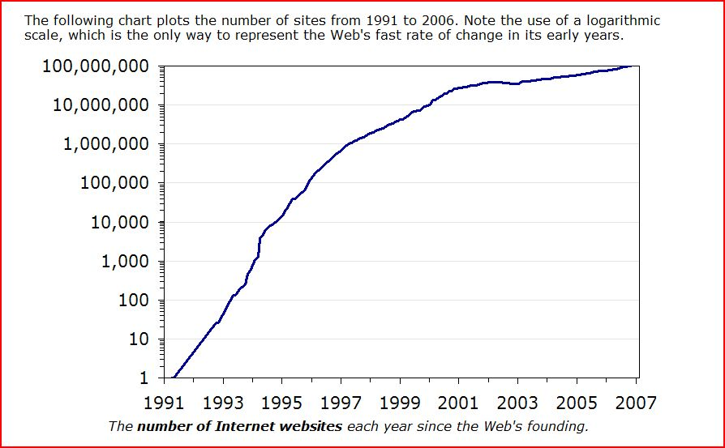
Web Growth
http://www.useit.com/alertbox/web-growth.html

Slide 13
Web Technologies

Slide 14
Tools: Servers on the Internet
HTTP - HyperText Transport Protocol
JSP and ASP add dynamic content
Web Services add RPC program interface
FTP - File Transport Protocol
Gopher - Text and Menus
NNTP - Network News Transfer Protocol
DNS - Distributed Name Service
telnet - log into a remote computer
New tools - if they use TCP/IP just add them

Slide 15
Network Protocols
OSI Model Layers
TCP/IP Protocol Architecture Layers
TCP/IP Protocol Suite
Application
Layer
Presentation
Layer
Application
Layer
Telnet
FTP
SMTP
DNS
RIP
SNMP
HTTP
Session
Layer
Host-to-Host
Transport
Layer
TCP
UDP
Transport
Layer
Network
Layer
Internet
Layer
IP
ARP
IGMP
ICMP
Data Link
Layer
Network
Interface
Layer
Ethernet
Token
Ring
Frame
Relay
ATM
Physical
Layer
Notes:
This figure depicts the different layers used in networking protocols.

Slide 16
Networks - Transport Layer
Provides efficient, reliable and cost-effective service
Uses Sockets programming model
Ports identify application
Well-known ports identify standard services (e.g. HTTP uses port 80, SMTP uses port 25)
Transmission Control Protocol (TCP)
Provides reliable, connection-oriented byte stream
UDP
Connectionless, efficient, unreliable

Slide 17
Communication Between Networks
Internet Protocol (IP)
Routable, connectionless datagram delivery
Specifies source and destination
Does not guarantee reliable delivery
Large message may be broken into many datagrams, not guaranteed to arrive in the order sent
Transport Control Protocol (TCP)
Reliable stream transport service
Datagrams are delivered to the receiving application in the order sent
Error control is provided to improve reliability

Slide 18
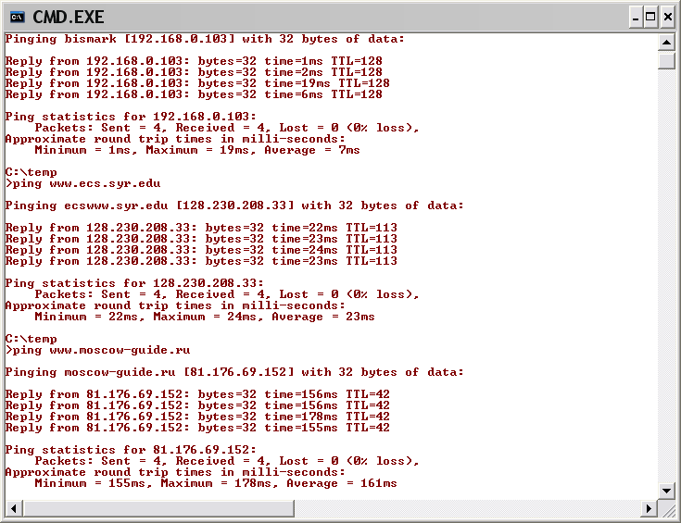
Pinging Various URLs
Ping in network
– few millisec
Ping in Syracuse
– few tens of millisec
Ping to Moscow
– few hundreds of millisec

Slide 19
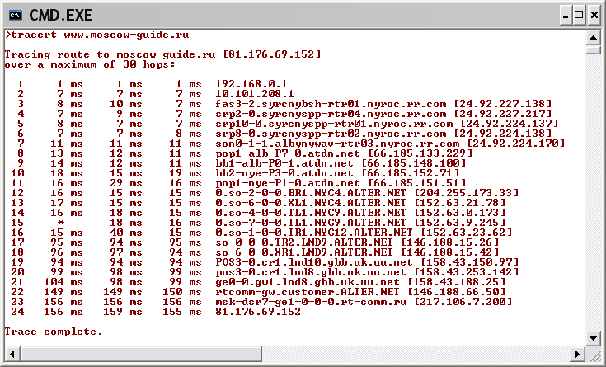
Tracing HTTP Message with Tracert

Slide 20
HTTP Messages as seen by packet sniffer
Request Message
TCP 113 192.168.0.102 207.46.144.188 2834 80 [2004.05.19 - 12:15:20.718]
E qSó@ €…šÀ¨ fÏ.¼ P‚X {ÈEPDpÑ¼ GET /ms.htm HTTP/1.1
Connection: Keep-Alive
Host: www.microsoft.com
TCP 1102 207.46.144.188 192.168.0.102 80 2834 [2004.05.19 - 12:15:20.843]
E N¢¬@ nEÏ.¼À¨ f P {ÈE‚XIPÿ¶jà HTTP/1.1 200 OK
Cache-Control: max-age=60
Content-Length: 669
Content-Type: text/html
Last-Modified: Thu, 11 Jul 2002 17:05:42 GMT
Accept-Ranges: bytes
ETag: "be61bb30fd28c21:27b"
Server: Microsoft-IIS/6.0
P3P: CP="ALL IND DSP COR ADM CONo CUR CUSo IVAo IVDo PSA PSD TAI TELo OUR SAMo CNT COM INT NAV ONL PHY PRE PUR UNI"
X-Powered-By: ASP.NET
Date: Wed, 19 May 2004 16:15:16 GMT
<!--TOOLBAR_START-->
<!--TOOLBAR_EXEMPT-->
<!--TOOLBAR_END-->
<!DOCTYPE HTML PUBLIC "-//W3C//DTD HTML 4.0 Transitional//EN"
"http://www.w3.org/TR/REC-html40/loose.dtd">
<HTML>
<HEAD>
<META HTTP-EQUIV="Refresh" CONTENT="0; URL=/">
<TITLE>Microsoft Corporation -- Where Do You Want to Go Today?</TITLE>
</HEAD>
<BODY BGCOLOR="#FFFFFF" TEXT="#000000">
<FONT FACE="Verdana, Arial, Helvetica" SIZE=2>
If your browser can't handle redirect, please click <a href="/">here</a>
</FONT>
</BODY>
</HTML>
method
Response Message
headers
message body

Slide 21
Typical HTTP Transaction
Client browser finds a machine address from an internet Domain Name Server (DNS).
Client and Server open TCP/IP socket connection.
Server waits for a request.
Browser sends a verb and an object:
GET XYZ.HTM or POST form
If there is an error server can send back an HTML-based explanation.
Server applies headers to a returned HTML file and delivers to browser.
Client and Server close connection.
It is possible for the client to request the connection stay open with HTTP 1.1.

Slide 23
HTTP Methods
GET request-URI HTTP/1.1
Retrieve entity specified in request-URI as body of response message
POST request-URI HTTP/1.1
Sends data in message body to the entity specified in request-URI
PUT request-URI HTTP/1.1
Sends entity in message body to become newly created entity specified by request-URI
HEAD request-URI HTTP/1.1
Same as GET except the server does not send specified entity in response message
DELETE request-URI HTTP/1.1
Request to delete entity specified in request-URI.
TRACE request-URI HTTP/1.1
Request for each host node to report back

Slide 24
HTTP Request
Method
File
HTTP version
Headers
GET /default.asp HTTP/1.0
Accept: image/gif, image/x-bitmap, image/jpeg, */*
Accept-Language: en
User-Agent: Mozilla/1.22 (compatible; MSIE 2.0; Windows 95)
Connection: Keep-Alive
If-Modified-Since: Sunday, 17-Apr-96 04:32:58 GMT
Blank line
Data – none for GET

Slide 25
Multipurpose Internet Mail Extensions (MIME)
Defines types of data/documents
text/plain
text/html
image/gif
image/jpeg
audio/x-pn-realaudio
audio/x-ms-wma
video/x-ms-asf
application/octet-stream

Slide 26
HTTP Response
HTTP version
Status code
Reason phrase
Headers
HTTP/1.0 200 OK
Date: Sun, 21 Apr 1996 02:20:42 GMT
Server: Microsoft-Internet-Information-Server/5.0
Connection: keep-alive
Content-Type: text/html
Last-Modified: Thu, 18 Apr 1996 17:39:05 GMT
Content-Length: 2543
<HTML> Some data... blah, blah, blah </HTML>
Data

Slide 27
Status Codes
200 OK
201 Created
202 Accepted
204 No Content
301 Moved Permanently
302 Moved Temporarily
304 Not Modified
400 Bad Request
401 Unauthorized
403 Forbidden
404 Not Found
500 Internal Server Error
501 Not Implemented
502 Bad Gateway
503 Service Unavailable
Classes:
1xx: Informational - not used, reserved for future
2xx: Success - action was successfully received, understood, and accepted
3xx: Redirection - further action needed to complete request
4xx: Client Error - request contains bad syntax or cannot be fulfilled
5xx: Server Error - server failed to fulfill an apparently valid request
Notes:
404, 403, 200, 304

Slide 28
Web Processing Models
HyperText Markup Language (HTML)
Web of linked documents
Unlimited scope of information content
HyperText Transfer Protocol (HTTP)
Universal access
HTTP is a "request-response" protocol specifying that a client will open a connection to server then send request using a very specific format. Server will then respond and close connection.
Graphical Browser Client
Sophisticated rendering makes authoring simpler
HTML File Server
Using HTTP, Interprets request, provides appropriate response, usually a file in HTML format

Slide 29
HTML Structure
HTML tag
Tagged Head section
declarations
Tagged Body section
Block elements
Headings, paragraphs, lists
Forms
Text fields, Buttons, Menus, …
Frames
Images
Links
Tables
Text

Slide 30
Take a look at the HTML of a page

Slide 31
Extension - Cascading Style Sheets
Help to separate content from presentation
Defines styles using C-structure like notation:
body { font-family: tahoma; font-size: medium; }
may apply to specific tags, as above
.notice { color: red; font-size: large; }
defines a class called notice
<span class=“notice”>…</span>
by default can be applied to any tag

Slide 32
Cascading style sheets introduced. Helps separate content from presentation.

Slide 33
Extension - JavaScript
Help separate content from behavior
Support dynamic presentation using JavaScript code sent to the browser
<script type=“text/javascript” src=“js/TopMenu.js”></script>

Slide 34
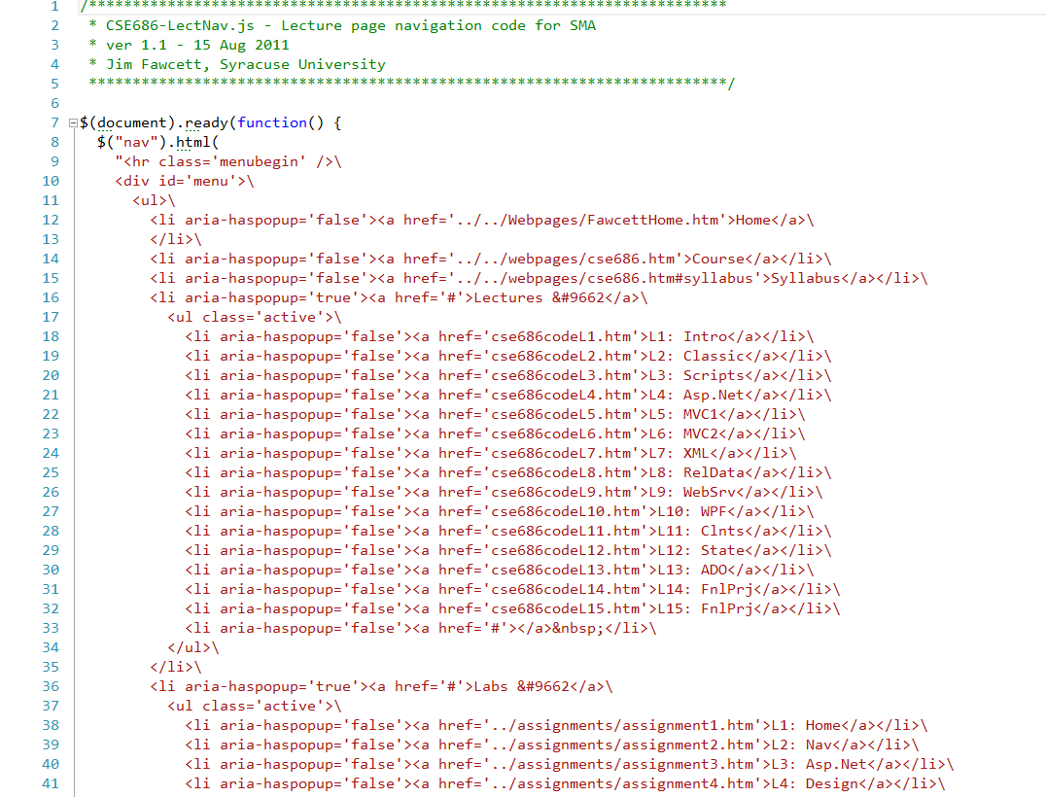

Slide 35
Programming The Web

Slide 36
Web Programming Model
Packaged functionality
Web server supports default and user supplied controls
Dynamic content display
ASP, JSP generates HTML using server data
Browser interprets client side scripts
Machine-to-Machine
Web services provide RPC interface

Slide 37
Programming the Web
Client-Side Programming
JavaScript
Dynamic HTML
Can modify html document using scripts sent from server and interpreted by client.
.Net controls – need permissions
Server-Side Programming
ASP script
Server components
C# code-behind
ADO
Web controls used on ASPX pages
Web services

Slide 38
Web Programming – Language Model

Slide 39
Programming the Web Server-Side Code
What is server-side code?
Software that runs on the server, not the client
Receives input from
URL parameters
HTML form data
Cookies
HTTP headers
Can access server-side databases, e-mail servers, files, mainframes, etc.
Dynamically builds a custom HTML response for a client
Notes:
This course will focus on server-side .NET technologies.

Slide 40
Traditional HTML Serving Model

Slide 41
ASP.NET Serving Model

Slide 42
Programming the Web Server-Side Code
Why server-side code?
Accessibility
You can reach the Internet from any browser, any device, any time, anywhere
Manageability
Does not require distribution of application code
Easy to change code
Security
Source code is not exposed
Once user is authenticated, can only allow certain actions
Scalability
Web-based 3-tier architecture can scale out

Slide 43
Three Tier Architecture
Client Tier
Presentation layer
Client UI, client-side scripts, client specific application logic
Server Tier
Application logic, server-side scripts, form handling, data requests
Data Tier
Data storage and access

Slide 44
Browser Object Model
Window
browser window
Document
current HTML page
Form
a form holds controls
often used to submit data to server
Frame
frame in browser window
Location
Location of current web page
URL, domain name, port, path, …
Navigator
Browser, itself
History

Slide 46
Server Side Programming with Asp.Net
An Asp.Net application consists of:
Design Time:
A form with web controls
C# code behind event handlers
Run-Time:
Form is translated into an HTML form
Web controls become HTML elements with Javascript event handlers that postback to the server.
Asp.Net model makes control data available as properties of a Page class, transported from browser to server in a “hidden view-state”.

Slide 47
Security Issues
Threats
Data integrity
code that deletes or modifies data
Privacy
code that copies confidential data and makes it available to others
Denial of service
code that consumes all of CPU time or disk memory.
Elevation of privilege
Code that attempts to gain administrative access

Slide 48
Protections
Least privilege rule:
Use the technology with the fewest capabilities that gets the job done.
Digital signing
Who are you?
Security zones
Trusted and untrusted sites
Secure sockets layer (SSL)
Transport layer security (TLS)
Encryption

Slide 49
End of Presentation

